Slide 1
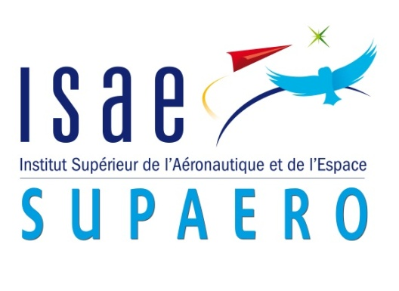


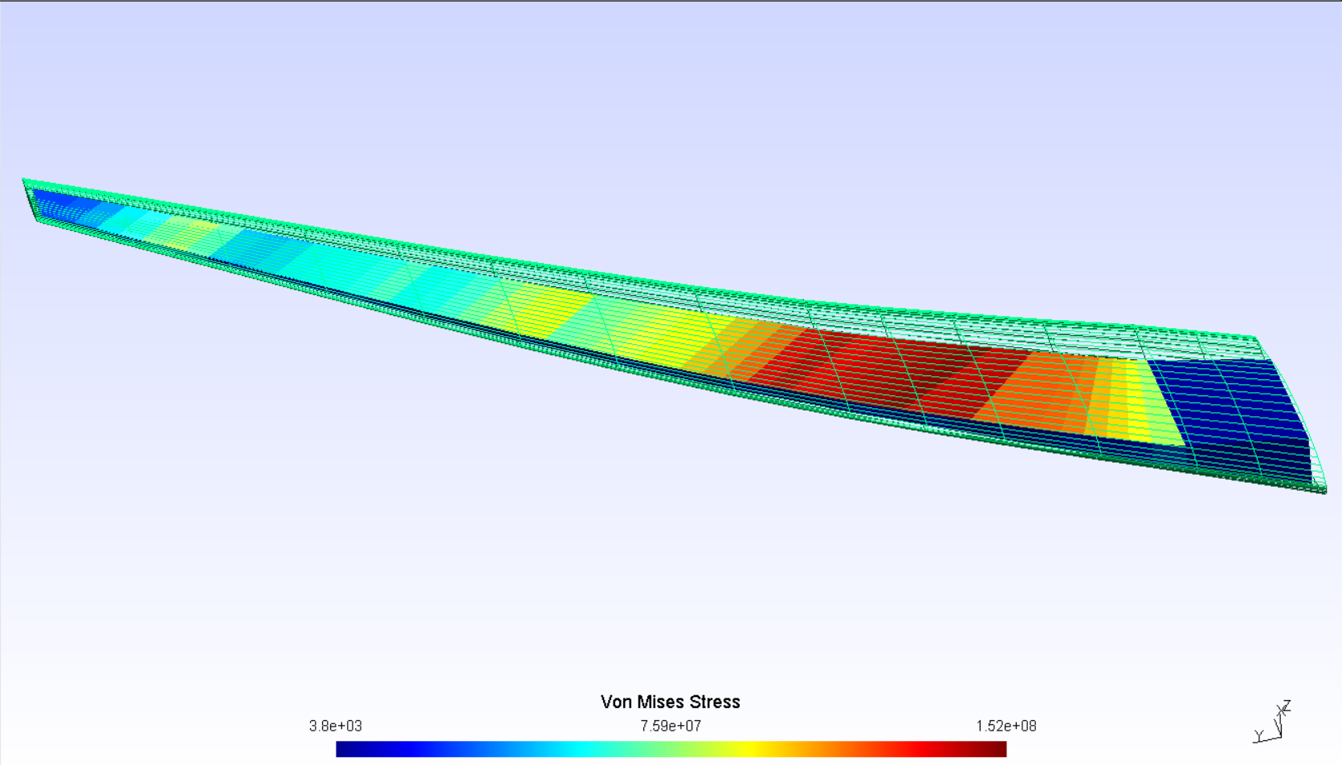
Multifidelity aeroelastic optimization with application to a BWB.
Gilberto RUIZ JIMÉNEZ¹;
Joan MAS COLOMER; Joseph MORLIER
1,2: ISAE-SUPAERO, Université de Toulouse, France 3: ICA, ONERA, France
1. gilberto.ruiz-jimenez@student.isae-supaero.fr
1. Introduction
3. Preliminary Results
Fluid-Structure interaction optimization problems are often hard to solve.
MDO libraries allow the user to couple both disciplines and optimize w.r.t. established bounds and variables [1].
Hi-Fi simulations offer accurate results but are often too expensive for direct design optimizations.
Lo-Fi analysis offer reasonable approximations with low computational demands.
Multifidelity methods leverage error and costs to speedup simulations [2].
The purpose of this work is to implement the aforementioned techniques to the development of a BWB concept aircraft.
Different iteration limits were set at the Lo-Fi levels to evaluate the evolution of the total execution time for a sample problem.
Fig. 2 shows the combination of iterations required for convergence of the linked MDA as well as the time to converge.
Accelerating the process is possible.
Iteration-based control → residual-based control for optimum performance.
The resulting shape and stress field is similar for all cases (Fig. 3).
4. Project Milestones
2. Proposed Method
Write the code that connects both fidelity levels in OpenMDAO.
Run the multi-fidelity optimization for the sample case.
Check performance of the new proposal vs. previous code and single fidelity.
Apply the method to a BWB configuration and validate the results.
Check for possible performance improvements for the complex case.
The base for the code development is the aerostructures package [3], which facilitates the creation of MDAO problems in OpenMDAO.
Open-source structural (NASTRAN) and fluid solvers (Panair, ADFlow) are coupled via the displacement field of the structure, then optimized w.r.t. CDi (Fig. 1).
At this stage the only difference between fidelities then is the size of the fluid mesh.
The philosophy is to build a progressively complex model, making sure that everything works at each step.
[1] Gray, J., Moore, K., & Naylor, B. (2010, September). OpenMDAO: An open source framework for multidisciplinary analysis and optimization. In 13th AIAA/ISSMO Multidisciplinary Analysis Optimization Conference (p. 9101).
[2] Peherstorfer, B., Willcox, K., & Gunzburger, M. (2018). Survey of multifidelity methods in uncertainty propagation, inference, and optimization. SIAM Review, 60(3), 550-591.
[3] Mas-Colomer, J. (2018). Aeroelastic Similarity of a Flight Demonstrator via Multidisciplinary Optimization (Doctoral dissertation, Université Fédérale de Toulouse).
Root_Optimizer (CDi/Breguet)
MDA_Lo-Fi
Displacement
Field
Structural
Solver
Displacement
Transfer
Aerodynamic
Solver
Load
Transfer
MDA_Hi-Fi
Structural
Solver
Displacement
Transfer
Aerodynamic
Solver
Load
Transfer
Filter
Fig. 3 Equivalent stress over an optimized wing .
Fig. 2 Performance plot of the current MDA multifidelity system.
Fig. 1 MDAO Diagram for the multifidelity scheme.

